Slide 1

CHURN-PREDICTION TELECOM
KNIME HACKATHON
BUAN 6342-501-GROUP 2
Amit | Mrudula |Dwaipayan

Slide 2

Agenda
Introduction
Data Preprocessing
Feature Engineering
Exploratory Data Analysis
Predictive Modelling
Model Comparisons
Insights & Recommendations

Slide 3

Introduction
Customer churn impacts profitability, making retention more cost-effective than acquisition (especially in the telecom sector)
Predicting churn allows companies to identify at-risk customers early and take targeted actions to improve satisfaction, loyalty, and engagement.
This project uses the KNIME Analytics Platform to analyze customer data, uncover churn patterns, and recommend retention strategies through predictive modeling.

Slide 4
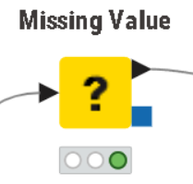
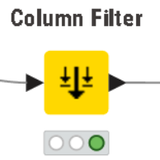
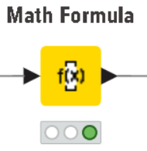
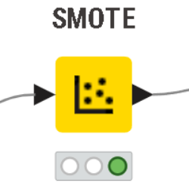
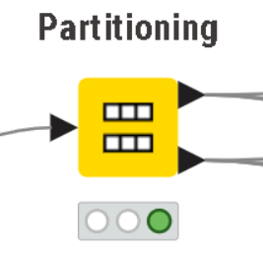
Data Preprocessing
Total Charges column had 11 missing values, which were replaced with mean of the column.
Filtered unwanted columns like CustomerID.
Balancing the data: Used SMOTE to oversample the minority class in the target variable.
Partitioning: Spilit the data into train and test set. A 70-30 split has been done here.
Transformation: Cube root transformation on the Total Charges column to reduce skewness

Slide 5
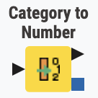
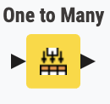
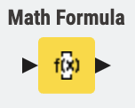
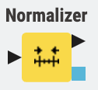
Feature Engineering
After filtering of missing values, the Yes/No columns are Label encoded (0/1) using the Category to Number node.
To encode columns with more than two categories, the One-hot encoding method was executed using the One to Many node.
The Math Formula node was used to create a new numerical column called 'Tenure to Total Ratio'.
Lastly, to avoid bias while training of the ML models, we normalize the data using the Z-scorer method by deploying the Normalizer node.

Slide 6
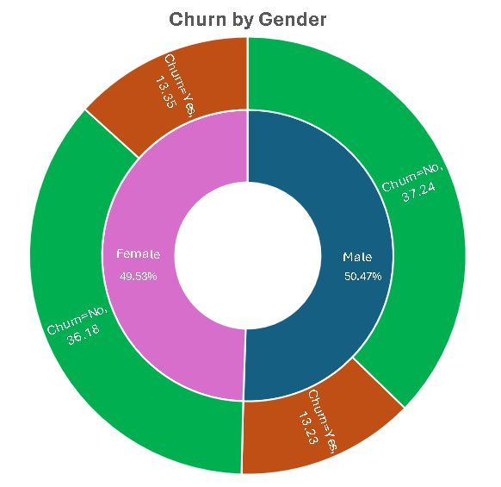
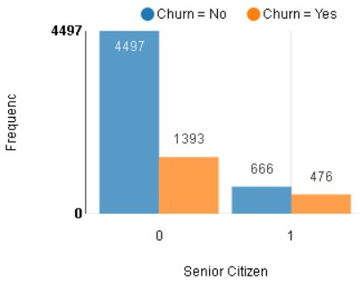
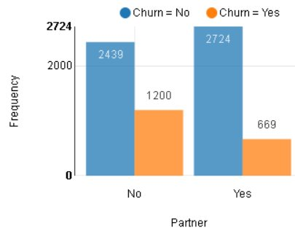
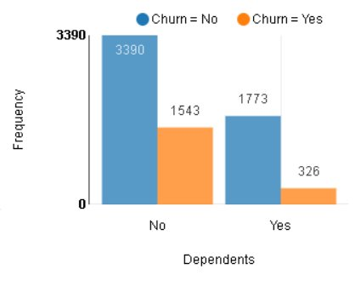
Exploratory Data Analysis -Demographics and Statistics
26.6 % of customers switched to another firm
71.4% of the senior citizens churned compared to 30.9% for non-senior citizens
49.2% of customers without partners churned compared to 24.5% for customers with partners
45.5% of customers without dependents churned compared to 18.3% for customers with dependents
In terms of gender Both groups behaved similarly when it comes to migrating to another service provider/firm.

Slide 7
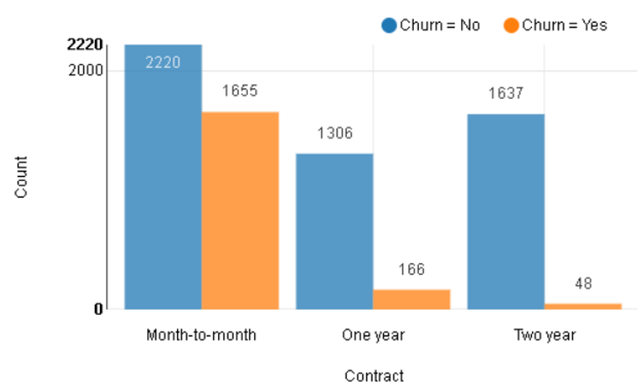
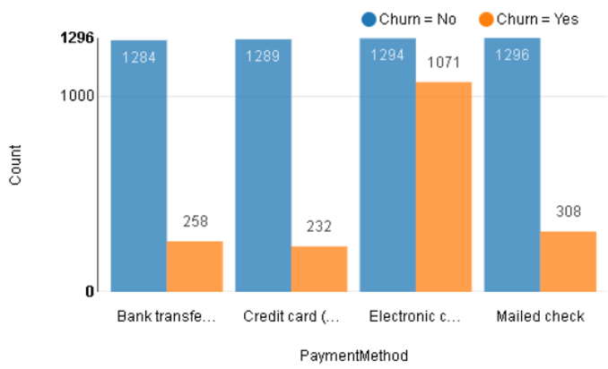
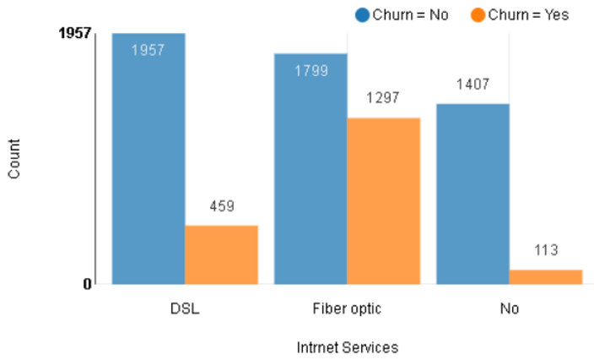
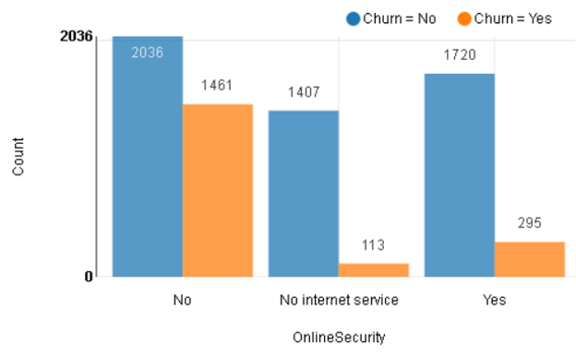
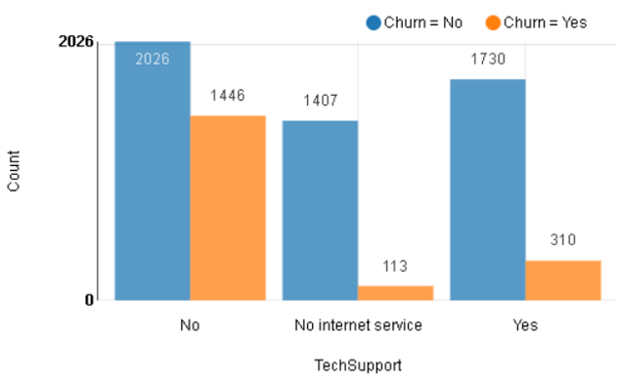
Exploratory Data Analysis - Other Drivers of Churn
75% of Month-to-Month contract users churned vs. 13% (One-Year) and 3% (Two-Year).
Electronic Check users have the highest churn rate among payment methods.
Fiber Optic users show higher churn, indicating possible dissatisfaction.
DSL users are more loyal with lower churn rates.
Lack of Online Security is strongly linked to higher churn.
Absence of Tech Support increases the likelihood of customer churn.

Slide 8
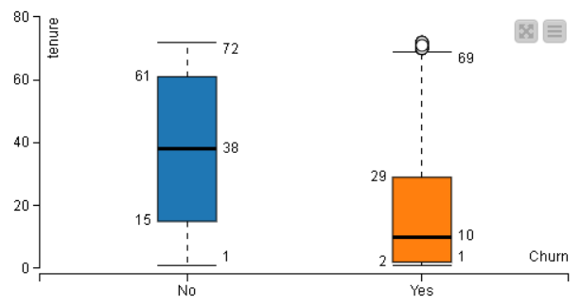
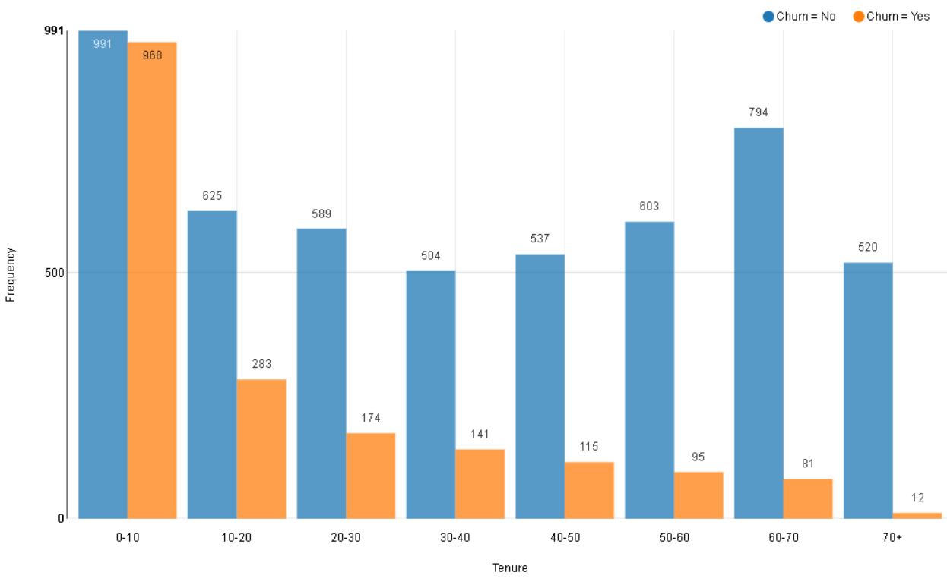
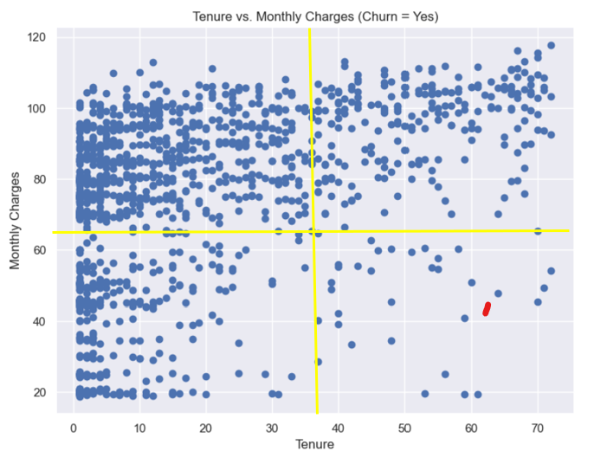
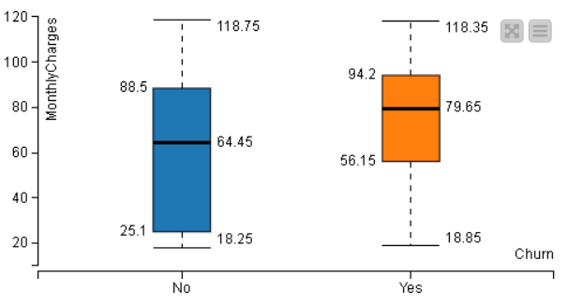
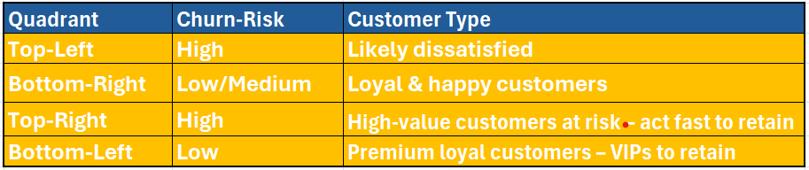
Exploratory Data Analysis -Tenure, Monthly Charges and Churn
New customers are more likely to churn – Tenure Vs Churn
Customers with higher Monthly Charges are also more likely to churn.
Churned customers forming dense clusters in the upper-left quadrant (high monthly charges, low tenure)
Table to the left details the risk profile and customer types.

Slide 9
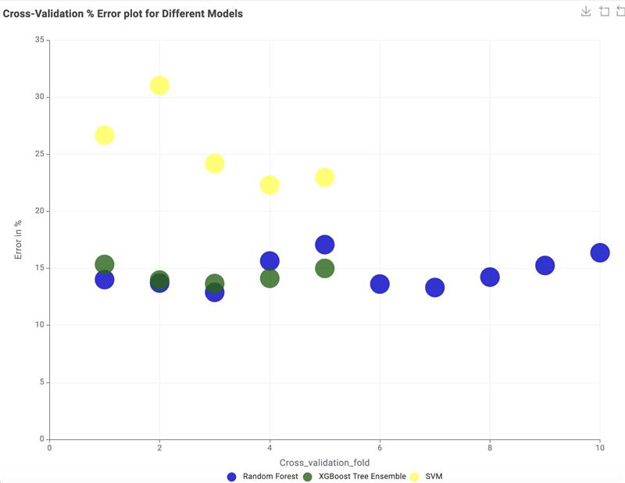
Hyperparameter Tuning and Cross-Validation
Models | Hyperparameters Passed | Best Hyperparameter combination
Logistic Regression | { ‘stepSize': 0.1 to 1 (step: 0.1) ‘priorVariance: 0.1 to 1 (step 0.1) } | { ‘stepSize’: 0.9, ‘priorVariance: 0.1 }
Random Forest | { ‘maxLevels’: 10 to 50 (step: 5), ‘minNodeSize’: 5 to 20 (step: 2) } | { ‘maxLevels’: 5, ‘minNodeSize’: 35 }
XGBoost Tree Ensemble | { ‘gamma’: 0 to 1 (step: 0.1), ‘maxDepth’: 1 to 10 (step: 1) } | { ‘gamma’: 0, ‘maxDepth’: 10 }
SVM | { ‘gamma’: 0 to 1 (step: 0.1), ‘c_parameter’: 0.1 to 1 (step: 0.3) } | { ‘gamma’: 0.1, ‘c_parameter’: 0.01 }

Slide 10

Model Performance Comparison
Model | Accuracy | Precision | Recall | F1 Score | Cohen’s Kappa
Logistic Regression | 0.786 | 0.637 | 0.438 | 0.519 | 0.387
Random Forest | 0.859 | 0.814 | 0.605 | 0.694 | 0.605
XGBoost Tree Ensemble | 0.881 | 0.821 | 0.725 | 0.77 | 0.69
SVM | 0.763 | 0.549 | 0.577 | 0.562 | 0.4

Slide 11
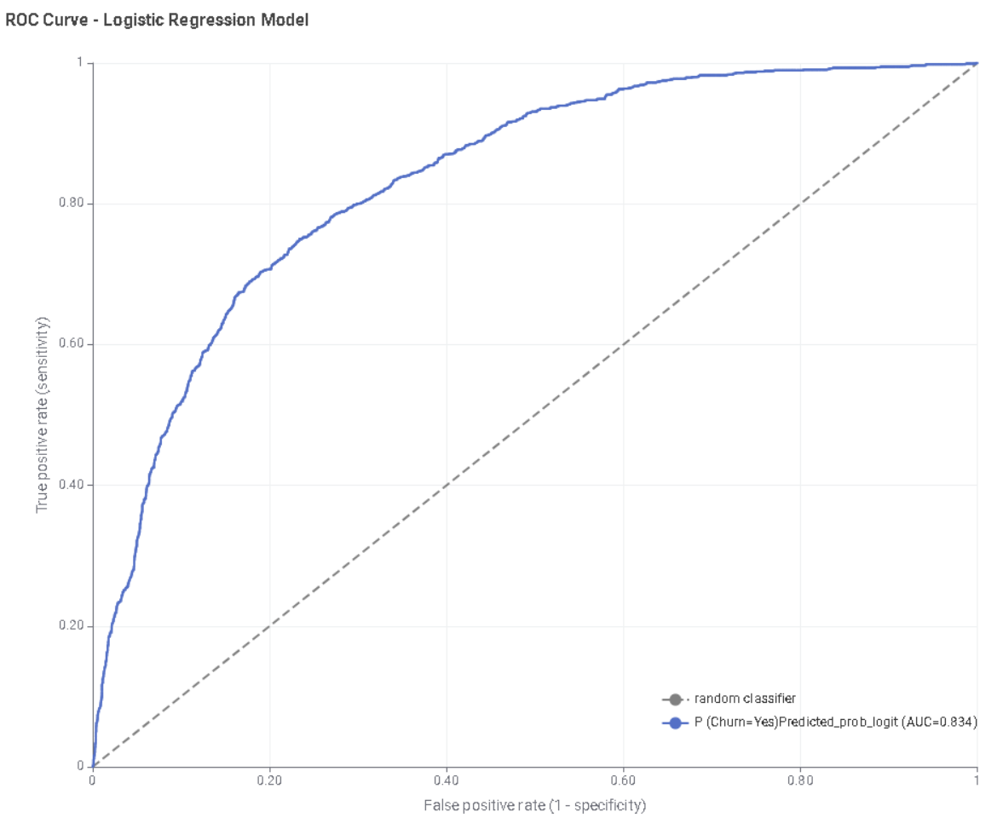
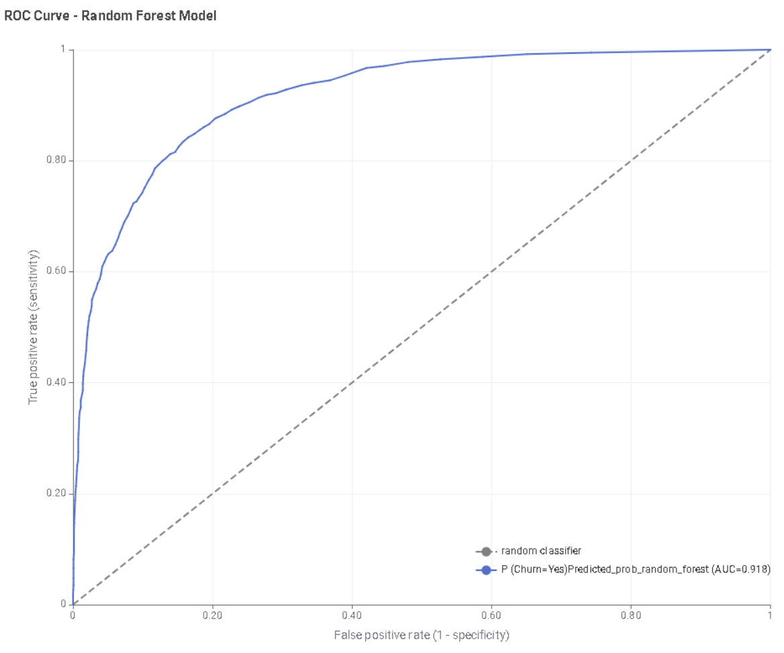
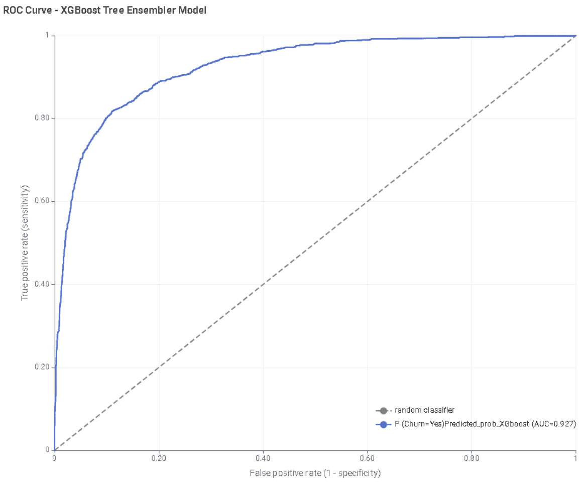
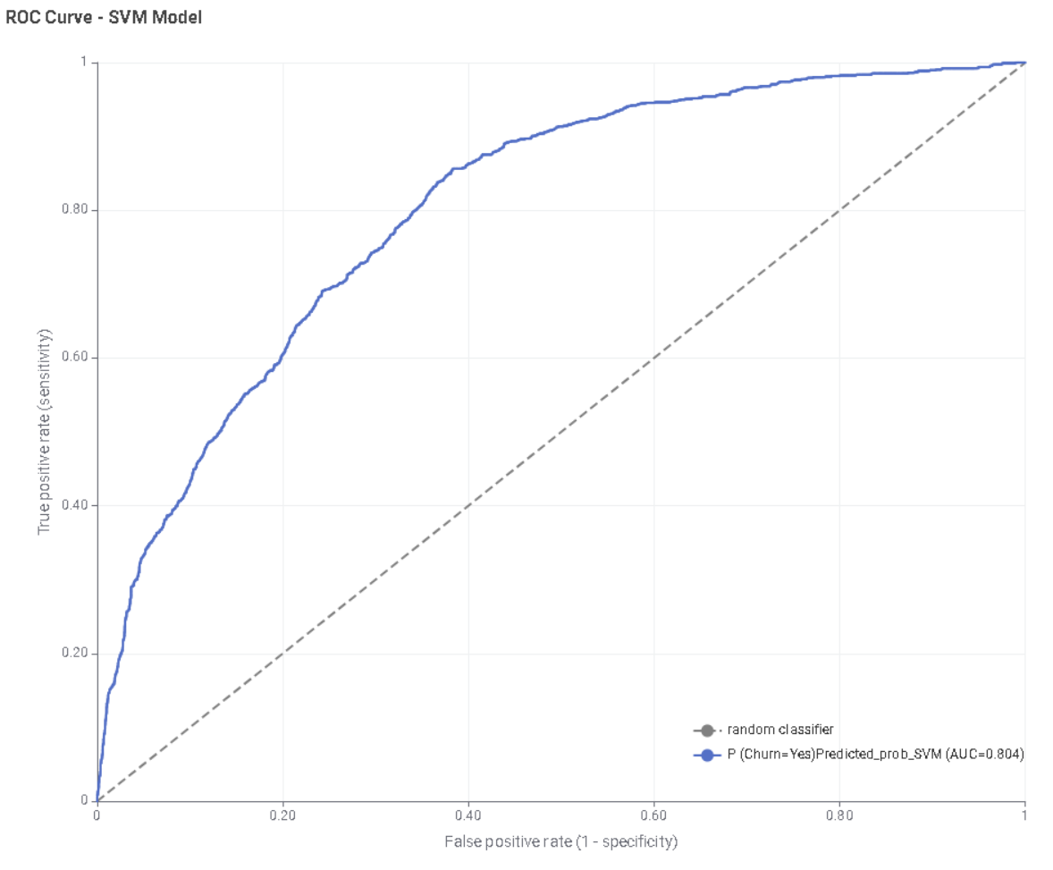
ROC Curves & Confusion Matrices
Actual Churn | Model | Final Predictions
 | Logistic Regression |  | Yes | No
 |  | Yes | 488 | 626
 |  | No | 278 | 2828
 | Random Forest |  | Yes | No
 |  | Yes | 674 | 440
 |  | No | 154 | 2952
 | XGBoost Tree Ensemble |  | Yes | No
 |  | Yes | 838 | 318
 |  | No | 183 | 2881
 | SVM |  | Yes | No
 |  | Yes | 643 | 471
 |  | No | 529 | 2577

Slide 12
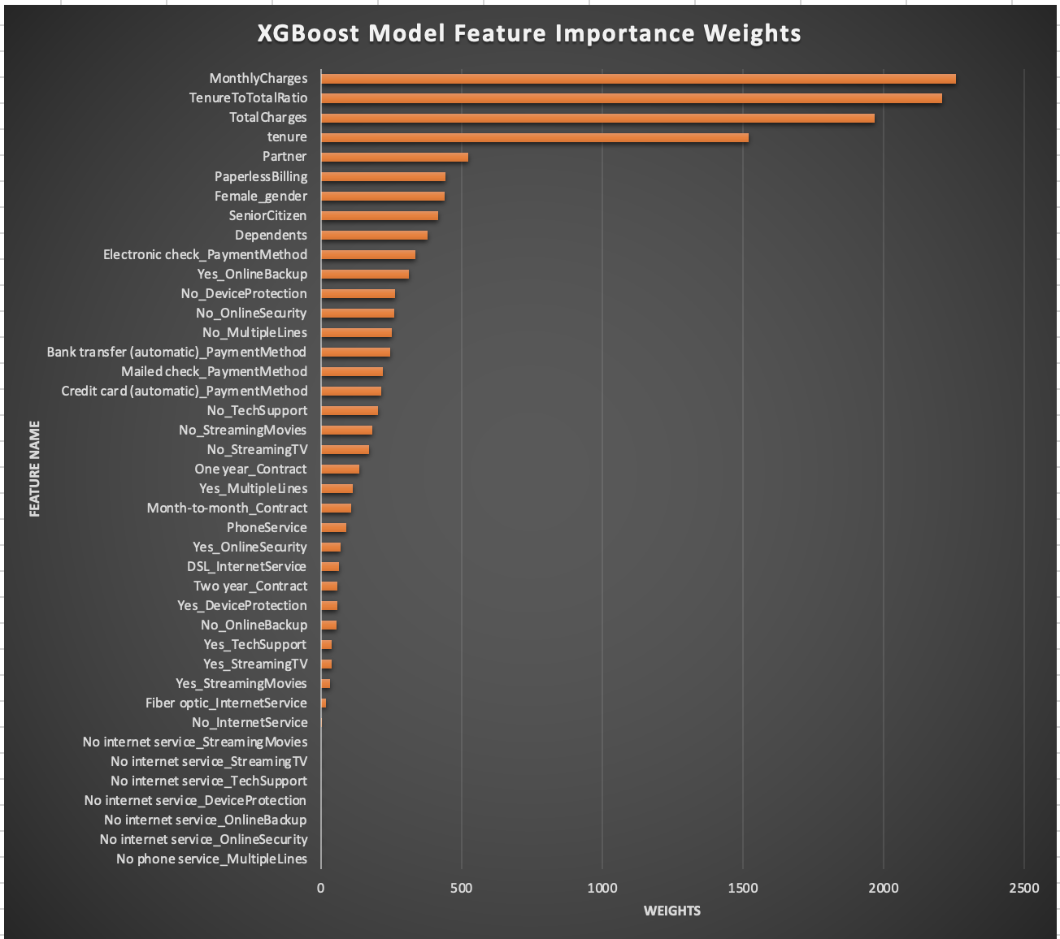
Feature Importance & Model Performance
XGBoost Tree Ensemble Model - The best-performing model, with 88.1% accuracy and minimal error.
Outperformed other simpler models in prediction accuracy and model efficiency.
Unlike logistic regression (linear) or SVM (limited kernel complexity), XGBoost Tree Ensemble Model automatically learns non-linear patterns and feature interactions.
It improves over time by learning from previous errors unlike the Random Forest model. Also, XGBoost is not sensitive to skewness or non-normality of variables.

Slide 13

Insights
Overall churn rate is 26.6%, with no gender bias.
Month-to-Month contracts drive 75% churn; long-term contracts reduce it.
High monthly charges and short tenure increase churn.
Lack of online security and tech support boosts churn.
Electronic Check users churn most; auto-pay users churn less.
Fiber Optic users churn more than DSL users.
Churn is higher among seniors and those without partners or dependents.

Slide 14

Strategic Recommendations
Reinforce
Reinforce Monthly Charges Perceived Value
Highlight values delivered for cost like speed, reliability, and included services.
Offer tiered pricing or loyalty discounts to long-term users.
Target
Target High-Risk Contract Users
Encourage Month-to-Month users to upgrade to 1- or 2-year contracts with perks or discounts.
Launch personalized retention offers for new customers with low tenure less than 3 months.
Upsell
Upsell Value-Add Services
Bundle add-ons like Online Security, Tech Support, and Streaming.
Use free trials to showcase value and increase adoption, reducing churn from customer lacking these
Segment and Personalize Offers
Target singles, non-dependents, and seniors with tailored support or discounts.
Position services as senior-friendly with guided tech support and assistance.
Revamp Payment Strategy
Encourage auto-payment options (card/bank transfer) by offering rewards like 1-month discount or bonus data.
Disincentivize electronic check payments with minor processing fees or limited perks.
Enhance Fiber Optic Experience
Address technical issues and satisfaction gaps.
Offer free audits or speed boosts to existing users before they churn.

